Slide 1
SOCIAL ENGNEERING ATTACKS
GUNASEKARA W.M.M
IT21226496

Slide 2
INTRODUTION
According to the US Department of Justice, social engineering attacks are one of the world's most serious threats.
According to Cyence, a cyber security analyst business, the United States was the country targeted by the most social engineering assaults in 2016, with the highest attack cost, followed by Germany and Japan.
According to estimates, these attacks cost the United States $121.22 billion.
Users of Equifax are still concerned about the hackers' cyberattack.
The increasing rise of social engineering attacks in today's networks is weakening the cyber security chain.

Slide 3
HISTORY
Many people, whether they realize it or not, want to be helpful and accepted. A social engineer can exploit this behavior to get a solid read on the target to see if their plan is working. Each of these approaches aims to use human emotions in a favorable or bad way to achieve its purpose.
Trust/ Distrust
Pretexting
Baiting
Quid Pro Quo

Slide 4
STAGES OF SOCIAL ENGINEERING ATTACKS
Information Gathering.
Establish Relationship and Rapport.
Exploitation
Execution
Information Gathering
Stablishing Relationships and Rapaport
Exploitation
Execution

Slide 5
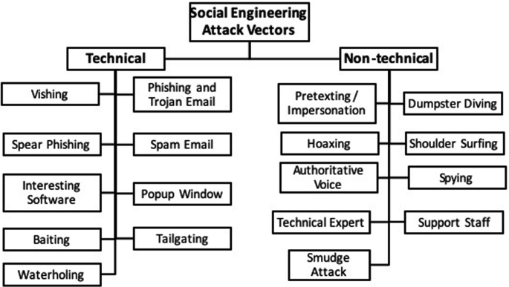
Classification of Attacks
There are two types of social engineering attacks,
Human-based attacks.
Computer-based attacks.
Depending on how they are carried out, social engineering attacks can be divided into three categories,
Physical attacks.
Technical attacks.
Social-based attacks

Slide 6
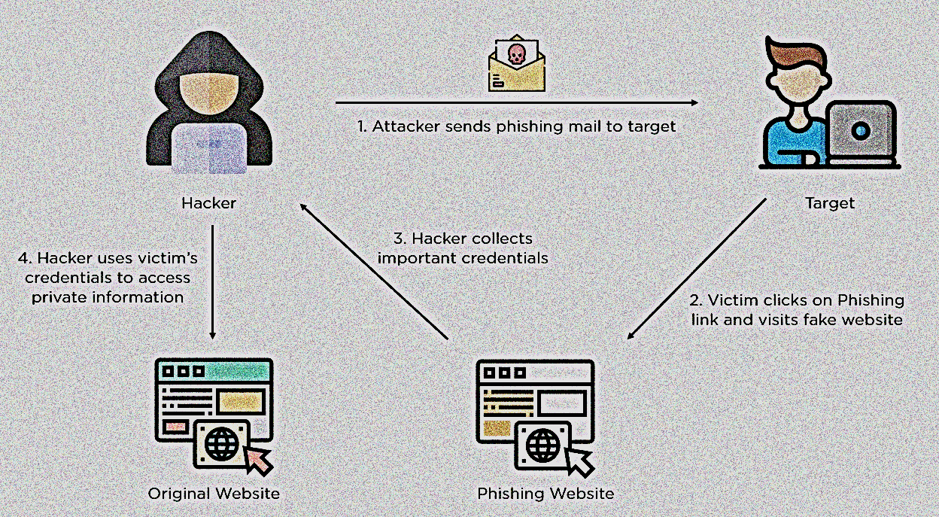
PHISHING ATTACK
Phishing is a form of social engineering attack that is frequently employed to obtain user information.
Trends and techniques
Payment/delivery scam
Invoice phishing
Downloads
Spear phishing
Business email compromise
Whaling

Slide 7
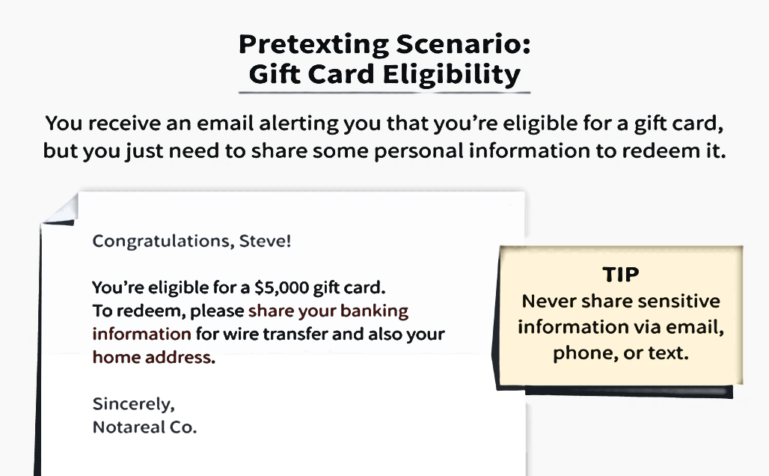
Pretexting attacks
A pretext is a made-up scenario developed by threat actors for the purpose of stealing a victim's personal data.
Trends and techniques
Tailgating
Piggybacking
Scareware
Impersonation

Slide 8
RANSOMEWARE ATTACK
.
Ransomware is a type of malicious software (malware) that threatens to publish or blocks access to data or a computer system, usually by encrypting it, until the victim pays a ransom fee to the attacker.
There are six stages to a ransomware attack
.
Reconnaissance
Initial access
Persistence
Lateral Movement/Collection
Command and control
Impact

Slide 9
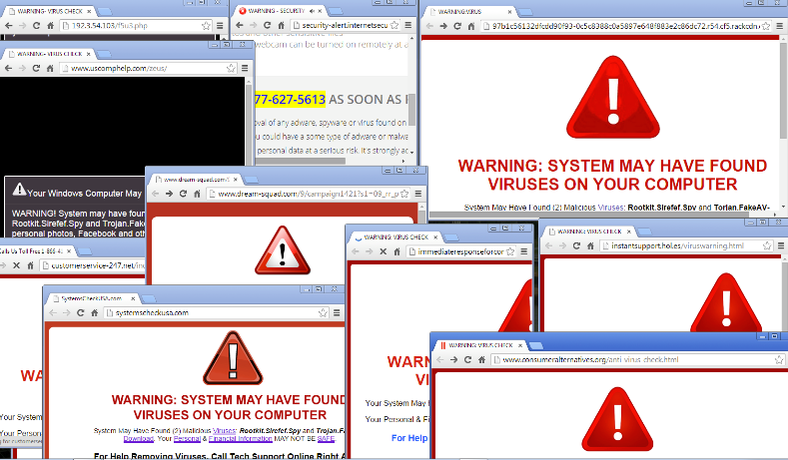
Pop-up windows
Pop-up window attacks are when windows alerting the target that the connection has been lost appear on their screen
Fake Software attacks
Fake software attacks, often known as fake websites, rely on fake websites to convince users that they are dealing with well-known and reliable software or websites
Robocalls attacks
A robocall is a device or computer program that automatically dials a list of phone numbers to deliver prerecorded messages

Slide 10
Prevention techniques
Multi-Factor Authentication
Continuously Monitor Critical System
Utilize Next-Gen cloud-based WAF
Verify Email Sender’s Identity
Check and Update your Security Patches
Enable Spam Filter

Slide 11
Future development areas
Promoting Awareness of Social Engineering attacks.
Organizing security orientations for new employees and informing all employees about the risks of attacks by forwarding sensitization emails and known fraudulent emails.
Encouraging security education and training.
Providing the required tools to detect and avoid these attacks.

Slide 12
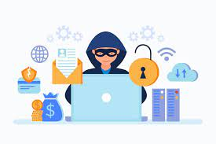
Conclusion
Social engineering attacks can surely be mitigated by updating security regulations and providing individuals with training. It is critical that all users understand the necessity of keeping information private. Such attacks are difficult to destroy or wipe out but raising public knowledge can aid in limiting the development of the networking epidemic.

Slide 13
References
[1] “An Overview of Social Engineering: Abstract,” Saylor Academy.
[2] “(PDF) Advanced social engineering attacks,” ResearchGate.
[3] “The Attack Cycle,” Security Through Education.
[4] Imperva, “What is phishing | Attack techniques & scam examples | Imperva,” Learning Center.
[5] Dansimp, “Phishing trends and techniques,” learn.microsoft.com.
[6] “What is Spear Phishing | How is it different from Whaling Attacks | Imperva,” Learning Center.
[7] “Scareware: Definition Examples & How to Prevent It | CrowdStrike,” crowdstrike.com.
[8] N. Sell, “The 6 Stages of a Ransomware Attack,” Wild Mint Studios, Jul. 20, 2022.
[9] A. Smith, M. Papadaki, and S. Furnell, “Improving Awareness of Social Engineering Attacks.” [Online].

Slide 14

.
.

